Slide 1
C Programming

Slide 2
Hello World
// assert.c
#include<stdio.h>
int main( ) {
int array[10] = {0};
printf(“%d”, array[10]);
printf(“Hello World”);
return 0;
}

Slide 3
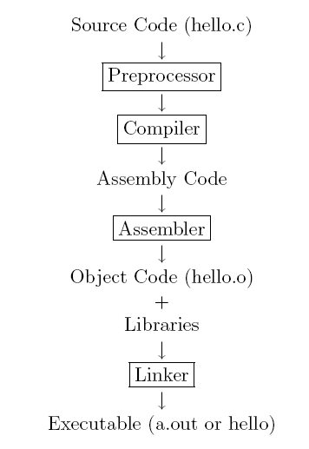
The C/ C++ compilation model

Slide 4
Preprocessor
The main function of the C/ C++ preprocessor is to remove comments from the source code and interpret preprocessor directives which are given by the statements that begin with #.
The #include statement can either be called with
#include<file.h>
or with
#include ‘‘file.h’’
CC –E hello.c
The first method tells the preprocessor to look for the file in the standard include directories, which for Linux are in /usr/lib/include.
The second method, which uses the quotes, tells the preprocessor to look for the file in current directory.

Slide 5
Compiling and Assembling
The compiler translates the C code into assembly language, which is a machine level code that contains instructions that manipulate the memory and processor directly, in a layer beneath the operating system.
Creating assembly code cc -S assert.c

Slide 6
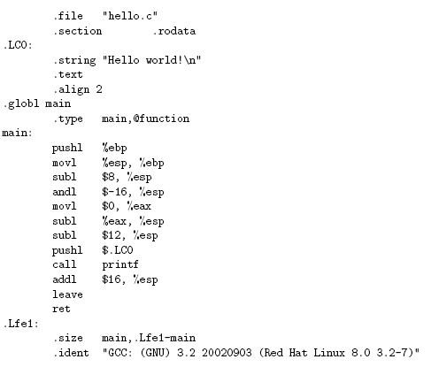
Assembly code

Slide 7
Linking
The object file assert.o contains a binary version of the machine language that was created from your source code assert.c.
Suppress the linking process and produce a .o file for each source file listed
Create a Object file using cc – c assert.s

Slide 8
Execute
The linker links other precompiled object files or libraries together and creates the executable assert. When you type
$ cc -o assert assert.c

Slide 9
Linking Stage
Static Linking
Dynamic Linking
Runtime Linking

Slide 10
Static Linking
Static linking means that for each function your program calls, the assembly to that function is actually included in the executable file.
Function calls are performed by calling the address of this code directly, the same way that functions of your program are called.

Slide 11
Dynamic Linking
Dynamic linking means that the library exists in only one location on the entire system, and the operating system's virtual memory system will map that single location into your program's address space when your program loads.
The address at which this map occurs is not always guaranteed.
Functions calls are performed by making calls to a compile-time generated section of the executable, called the Procedure Linkage Table(a huge array of jump instructions to the proper addresses of the mapped memory)

Slide 12
Runtime Linking
Runtime linking is linking that happens when a program requests a function from a library it was not linked against at compile time.
The library is mapped with dlopen() under UNIX, and LoadLibrary() under Microsoft Windows�, both of which return a handle that is then passed to symbol resolution functions (dlsym() and GetProcAddress())
It returns a function pointer that may be called directly from the program as if it were any normal function.
This approach is often used by applications to load user-specified plugin libraries with well-defined initialization functions.

